Slide 1
多圖形及其他進階練習題
黃建傑

Slide 2
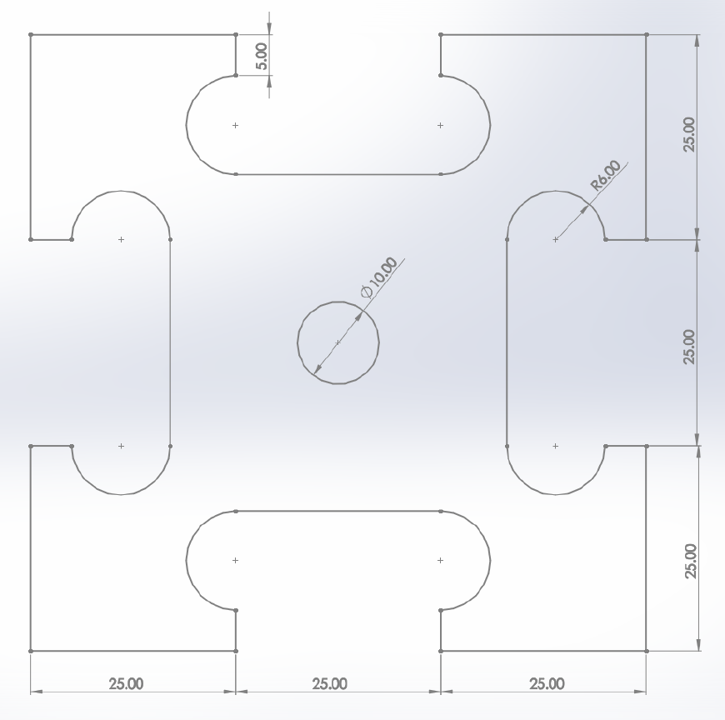
程式編輯 例題7
如圖所示，請用程式指令完成下方圖形輪廓，假設雷射起點在程式原點(0,0)上，請使用絕對座標完成下方圖形。
Y
H
O
I
N
X
J
M
K
L
G
F
E
I
R
Q
P
B
C
D
程式原點(0,0)=圓心
S
T
U
C'
Z
Y
A'
X
V
A(-37.5,-37.5)
B'
W

Slide 3
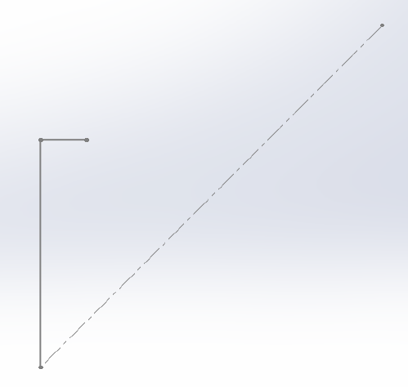
絕對座標 (G90)
M05 S0
G90
G21
G1 F600
G0 X-37.5 Y-37.5
G4 P0
M03 S255
G4 P0
G1 F600
G1 X-37.5 Y-12.5
G1 X-32.5 Y-12.5
Y
程式原點
X
B(-37.5,-12.5)
C(-32.5,-12.5)
A(-37.5,-37.5)

Slide 4
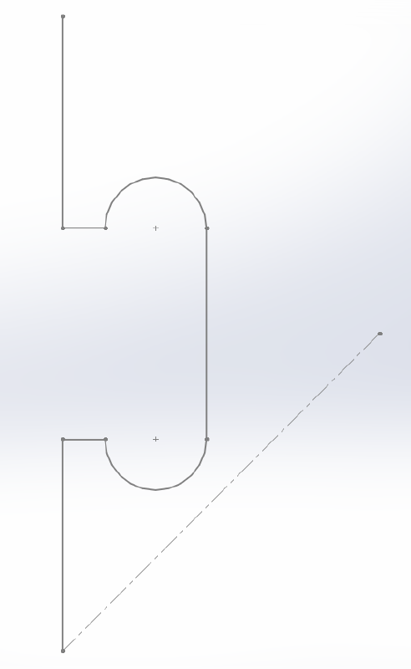
G3 X-20.5 Y-12.5 I6. J0.
G1 X-20.5 Y12.5
G3 X-32.5 Y12.5 I-6. J0.
G1 X-37.5 Y12.5
G1 X-37.5 Y37.5
H(-37.5,37.5)
Y
X
G(-37.5,12.5)
F(-32.5,12.5)
E(-20.5,12.5)
程式原點
B(-37.5,-12.5)
C(-32.5,-12.5)
D(-20.5,-12.5)
A(-37.5,-37.5)

Slide 5
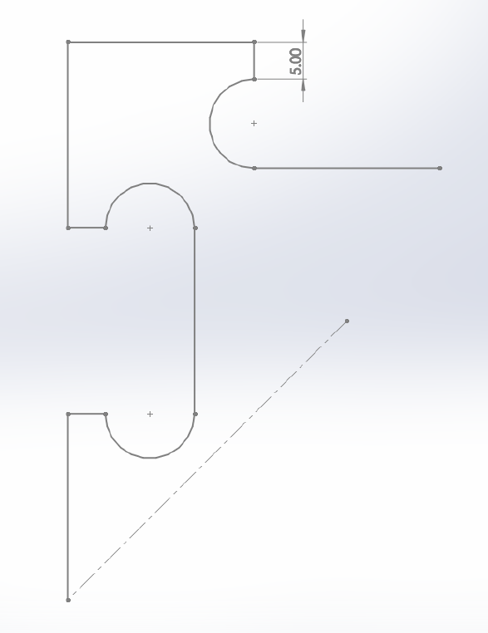
G1 X-12.5 Y37.5
G1 X-12.5 Y32.5
G3 X-12.5 Y20.5 I0. J-6.
G1 X12.5 Y20.5
H(-37.5,37.5)
I(-12.5,37.5)
Y
J(-12.5,32.5)
X
K(-12.5,20.5)
L(12.5,20.5)
G(-37.5,12.5)
F(-32.5,12.5)
E(-20.5,12.5)
程式原點
B(-37.5,-12.5)
C(-32.5,-12.5)
D(-20.5,-12.5)
A(-37.5,-37.5)

Slide 6
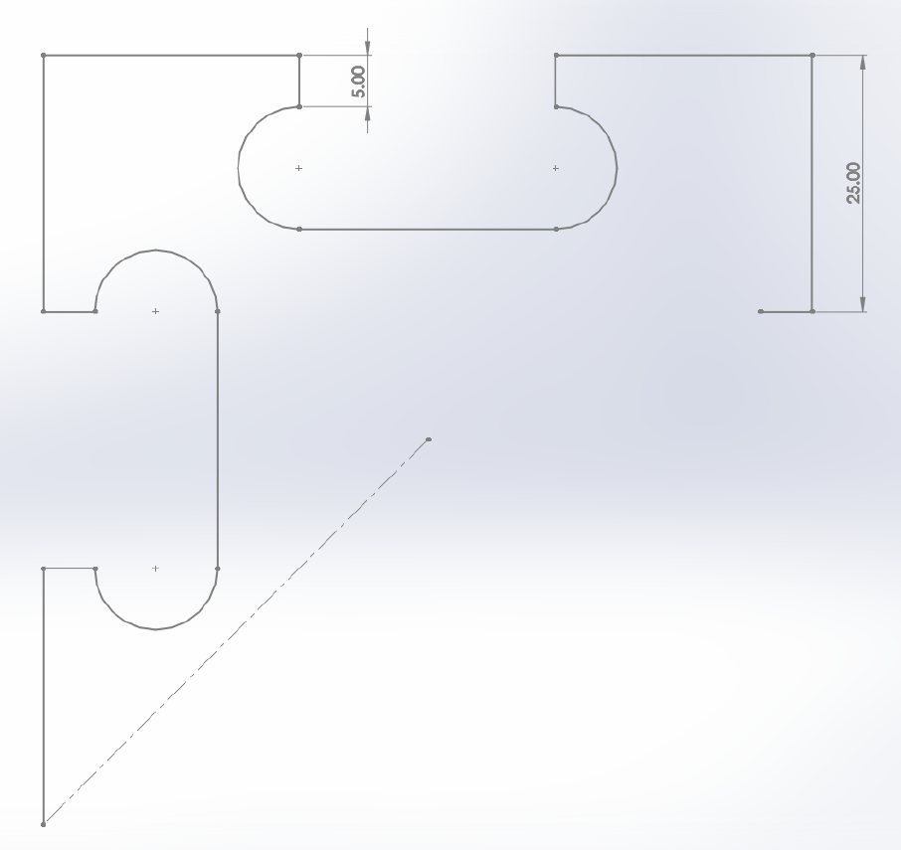
G3 X12.5 Y32.5 I0. J6.
G1 X12.5 Y37.5
G1 X37.5 Y37.5
G1 X37.5 Y12.5
G1 X32.5 Y12.5
H(-37.5,37.5)
I(-12.5,37.5)
N(12.5,37.5)
O(37.5,37.5)
J(-12.5,32.5)
M(12.5,32.5)
K(-12.5,20.5)
L(12.5,20.5)
G(-37.5,12.5)
F(-32.5,12.5)
E(-20.5,12.5)
Q(32.5,12.5)
P(37.5,12.5)
程式原點
B(-37.5,-12.5)
C(-32.5,-12.5)
D(-20.5,-12.5)
Y
A(-37.5,-37.5)
X

Slide 7
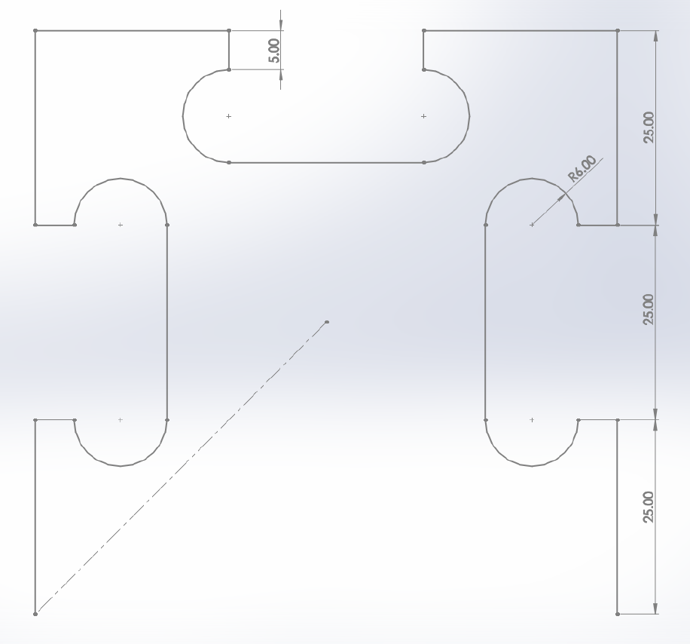
G3 X20.5 Y12.5 I-6. J0.
G1 X20.5 Y-12.5
G3 X32.5 Y-12.5 I6. J0.
G1 X37.5 Y-12.5
G1 X37.5 Y-37.5
I(-12.5,37.5)
N(12.5,37.5)
H(-37.5,37.5)
O(37.5,37.5)
J(-12.5,32.5)
M(12.5,32.5)
K(-12.5,20.5)
L(12.5,20.5)
G(-37.5,12.5)
F(-32.5,12.5)
E(-20.5,12.5)
R(20.5,12.5)
Q(32.5,12.5)
P(37.5,12.5)
程式原點
B(-37.5,-12.5)
C(-32.5,-12.5)
D(-20.5,-12.5)
S(20.5,-12.5)
T(32.5,-12.5)
U(37.5,-12.5)
Y
A(-37.5,-37.5)
X
V(37.5,-37.5)

Slide 8
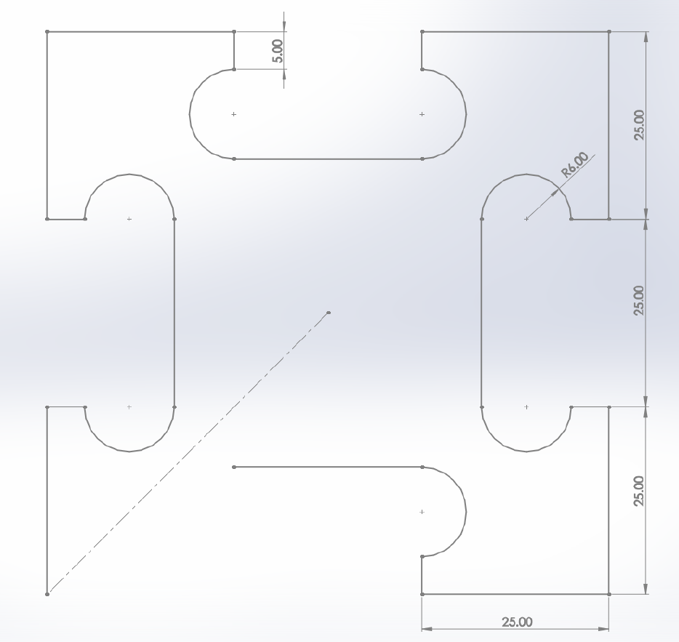
G1 X12.5 Y-37.5
G1 X12.5 Y-32.5
G3 X12.5 Y-20.5 I0. J6.
G1 X-12.5 Y-20.5
Y
I(-12.5,37.5)
N(12.5,37.5)
X
H(-37.5,37.5)
O(37.5,37.5)
J(-12.5,32.5)
M(12.5,32.5)
K(-12.5,20.5)
L(12.5,20.5)
G(-37.5,12.5)
F(-32.5,12.5)
E(-20.5,12.5)
R(20.5,12.5)
Q(32.5,12.5)
P(37.5,12.5)
程式原點
B(-37.5,-12.5)
C(-32.5,-12.5)
D(-20.5,-12.5)
S(20.5,-12.5)
T(32.5,-12.5)
U(37.5,-12.5)
Z(-12.5,-20.5)
Y(12.5,-20.5)
X(12.5,-32.5)
A(-37.5,-37.5)
W12.5,-37.5)
V(37.5,-37.5)

Slide 9
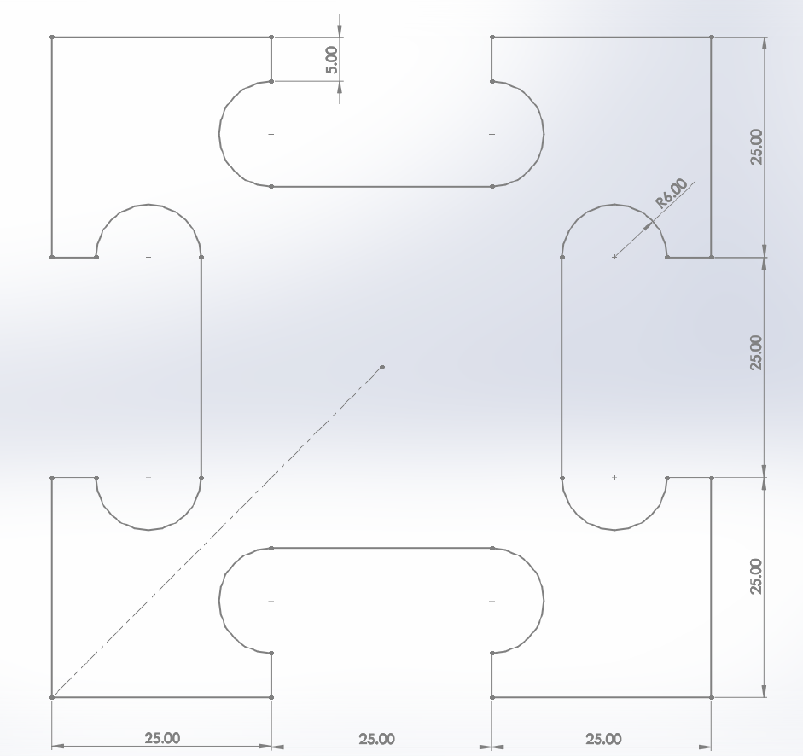
G3 X-12.5 Y-32.5 I0. J-6.
G1 X-12.5 Y-37.5
G1 X-37.5 Y-37.5
G4 P0
M05 S0
G0 X0. Y0.
Y
I(-12.5,37.5)
N(12.5,37.5)
H(-37.5,37.5)
O(37.5,37.5)
X
J(-12.5,32.5)
M(12.5,32.5)
K(-12.5,20.5)
L(12.5,20.5)
G(-37.5,12.5)
F(-32.5,12.5)
E(-20.5,12.5)
R(20.5,12.5)
Q(32.5,12.5)
P(37.5,12.5)
程式原點
B(-37.5,-12.5)
C(-32.5,-12.5)
D(-20.5,-12.5)
S(20.5,-12.5)
T(32.5,-12.5)
U(37.5,-12.5)
Z(-12.5,-20.5)
Y(12.5,-20.5)
A'(-12.5,-32.5)
X(12.5,-32.5)
V(37.5,-37.5)
A(-37.5,-37.5)
B'(-12.5,-37.5)
W12.5,-37.5)

Slide 10
M05 S0
G0 X0. Y-5.
G4 P0
M03 S255
G4 P0
G1 F600
由於此題型為兩個圖形組合，在第一個圖形完成後已關閉雷射，故下一圖形開始必須重新設定加工參數。
紅色標示處可以合併，並非一定要快速定位回程式原點才可進行下一流程，但撰寫時分開較方便檢查(下個例題會示範合併)

Slide 11
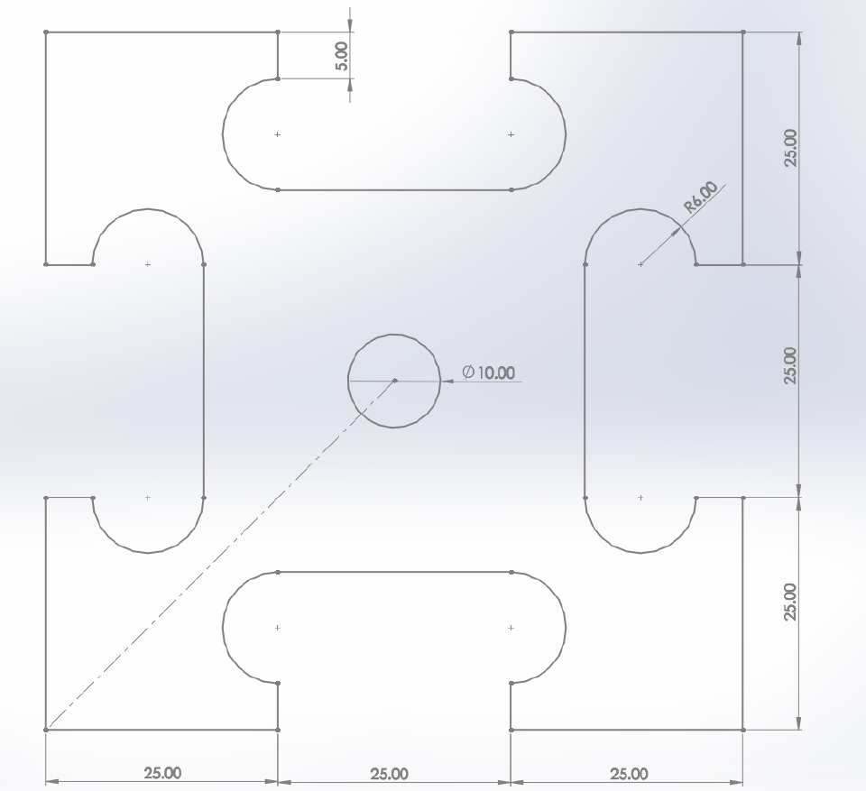
G3 X0. Y-5. I0. J5.
G4 P0
M05 S0
G0 X0 Y0
M18
Y
H(-37.5,37.5)
I(-12.5,37.5)
N(12.5,37.5)
O(37.5,37.5)
X
J(-12.5,32.5)
M(12.5,32.5)
K(-12.5,20.5)
L(12.5,20.5)
G(-37.5,12.5)
F(-32.5,12.5)
E(-20.5,12.5)
R(20.5,12.5)
Q(32.5,12.5)
P(37.5,12.5)
程式原點
C'(0,-5)
B(-37.5,-12.5)
C(-32.5,-12.5)
D(-20.5,-12.5)
S(20.5,-12.5)
T(32.5,-12.5)
U(37.5,-12.5)
Z(-12.5,-20.5)
Y(12.5,-20.5)
A'(-12.5,-32.5)
X(12.5,-32.5)
A(-37.5,-37.5)
B'(-12.5,-37.5)
W12.5,-37.5)
V(37.5,-37.5)

Slide 12
說明
當題型為多個圖形組合，在上一個圖形完成後會輸入關閉雷射指令，故下一圖形開始必須重新設定加工參數。
若題型為多個圖形組合，請使用絕對座標(G90)撰寫程式，Cubbi在使用相對座標(G91)加工多圖形(2個以上)組合時，較容易發生失誤，故建議使用者盡量使用絕對座標加工(僅限Cubiio)。

Slide 13
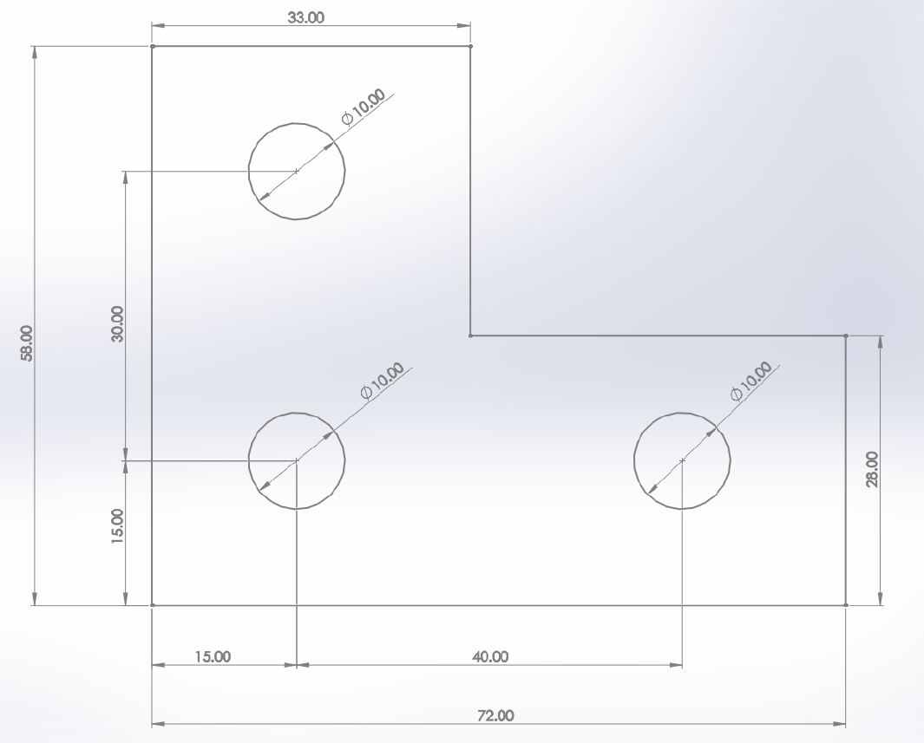
程式編輯 例題8
如圖所示，請用程式指令完成下方圖形輪廓，假設雷射起點在程式原點(0,0)上，請使用絕對座標完成下方圖形。
Y
B
C
X
I
D
E
G
H
A(-36,-29)
F

Slide 14
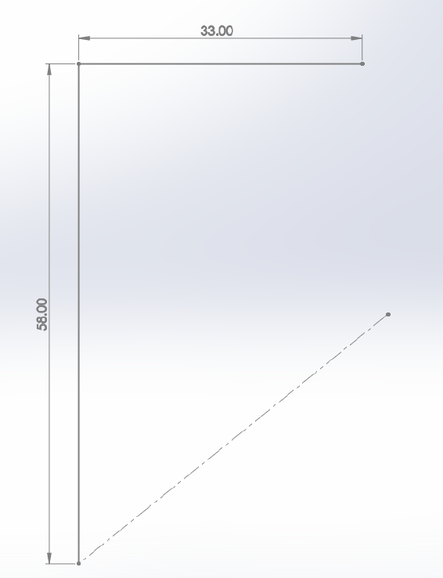
絕對座標 (G90)
M05 S0
G90
G21
G1 F600
G0 X-36. Y-29.
G4 P0
M03 S255
G4 P0
G1 F600
G1 X-36. Y29.
G1 X-3. Y29.
B(-36,29)
C(-3,29)
程式原點
A(-36,-29)
Y
X

Slide 15
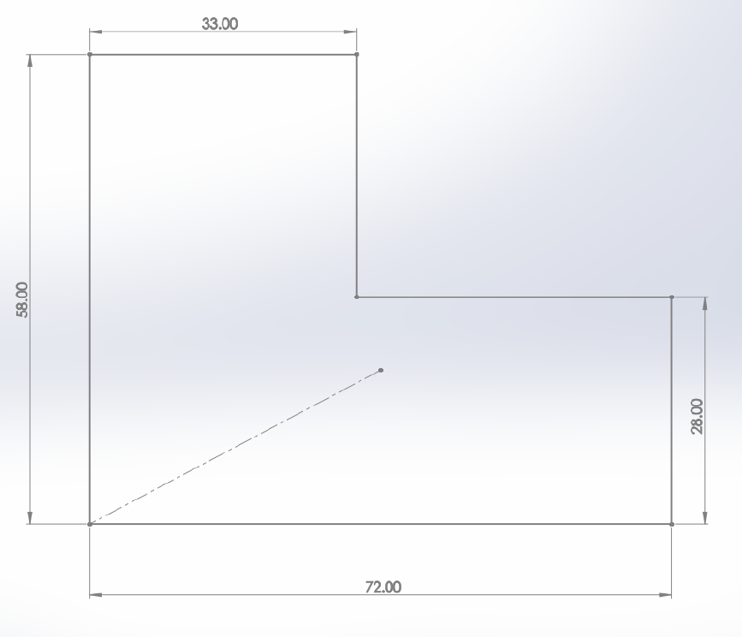
G1 X-3. Y-1.
G1 X36. Y-1.
G1 X36. Y-29.
G1 X-36. Y-29.
G4 P0
M05 S0
G0 X-21. Y-19.
G4 P0
B(-36,29)
C(-3,29)
Y
X
D(-3,-1)
E(36,-1)
程式原點
A(-36,-29)
F(36,-29)

Slide 16
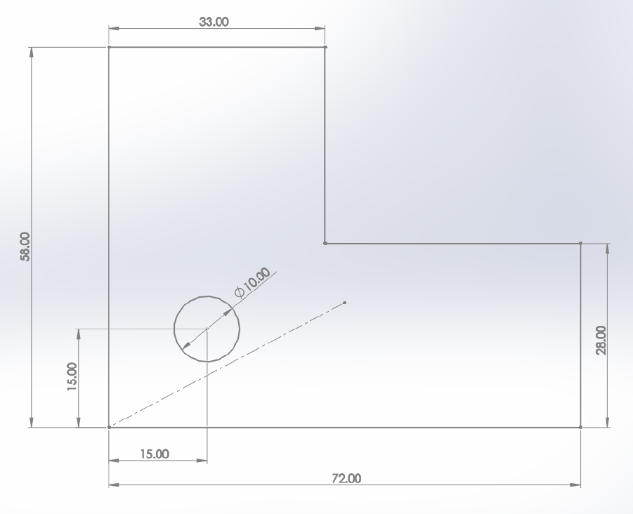
M03 S255
G4 P0
G3 X-21. Y-19. I0. J5.
G4 P0
M05 S0
G0 X-21. Y11.
G4 P0
M03 S255
B(-36,29)
C(-3,29)
Y
X
D(-3,-1)
E(36,-1)
程式原點
G(-21,-19)
A(-36,-29)
F(36,-29)

Slide 17
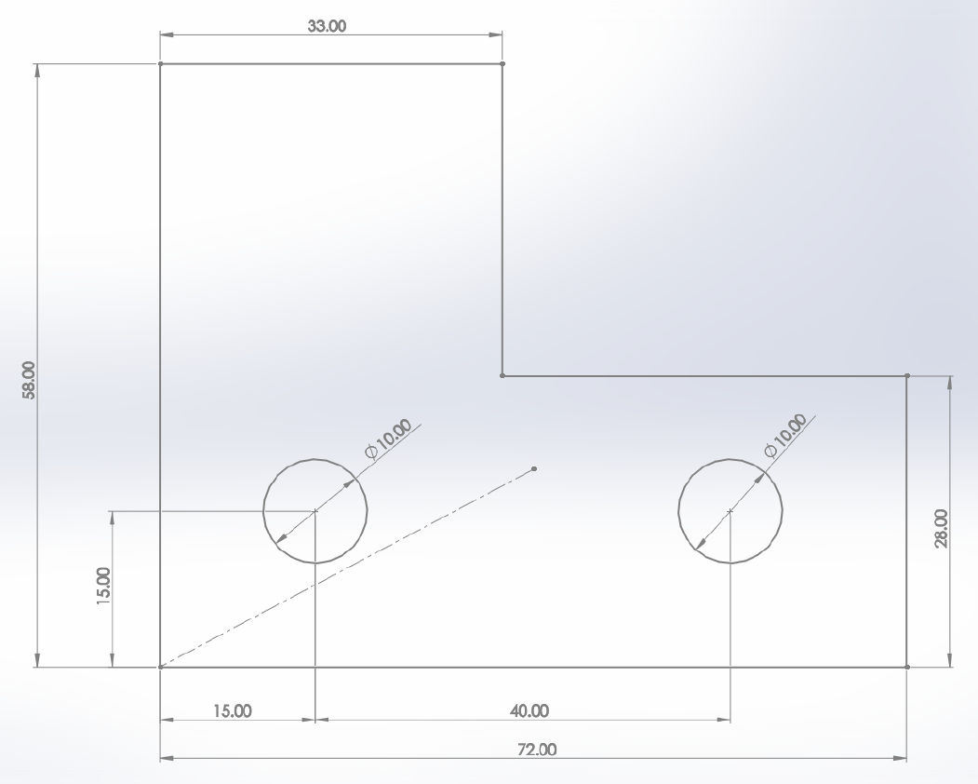
G4 P0
G3 X-21. Y11. I0. J5.
G4 P0
M05 S0
G0 X19. Y-19.
G4 P0
M03 S255
G4 P0
B(-36,29)
C(-3,29)
Y
X
D(-3,-1)
E(36,-1)
程式原點
G(-21,-19)
H(19,-19)
A(-36,-29)
F36,-29)

Slide 18
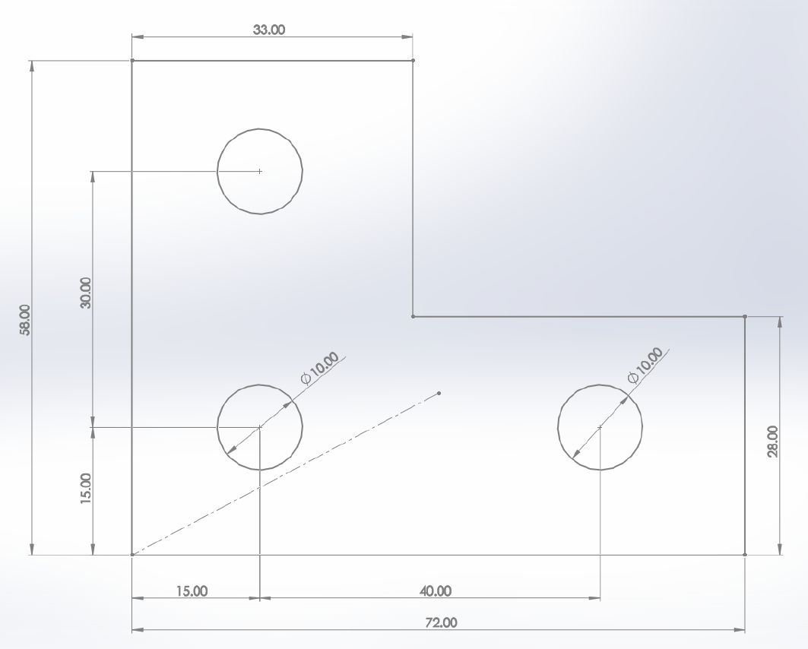
G3 X19. Y-19. I0. J5.
G4 P0
M05 S0
G0 X0 Y0
M18
Y
B(-36,29)
C(-3,29)
X
I(-21,11)
D(-3,-1)
E(36,-1)
程式原點
G(-21,-19)
H(19,-19)
A(-36,-29)
F36,-29)

Slide 19
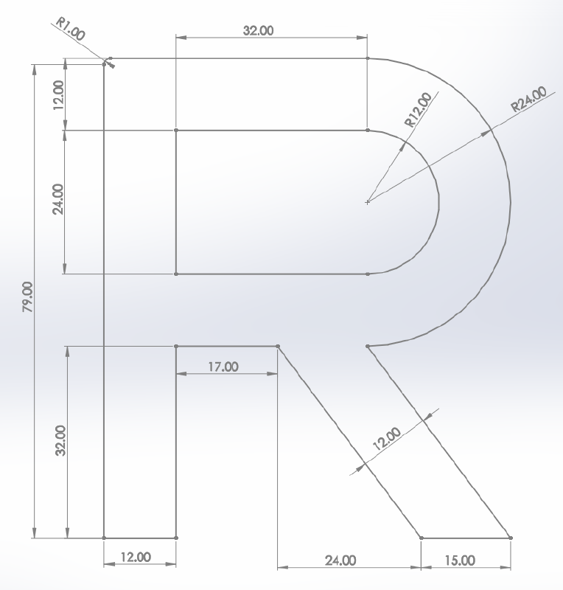
程式編輯 例題9
如圖所示，請用程式指令完成下方圖形輪廓，假設雷射起點在程式原點(0,0)上，請使用絕對座標完成下方圖形。
Y
C
D
X
B
K
L
N
M
I
H
E
A
J
G
F

Slide 20
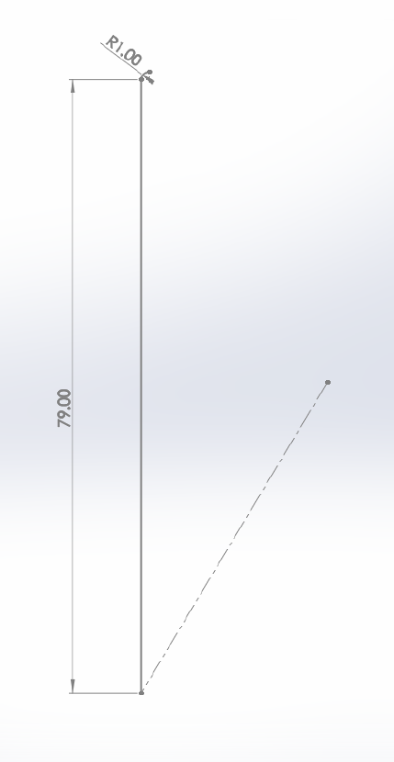
絕對座標 (G90)
M05 S0
G90
G21
G1 F600
G0 X-34. Y-40.
G4 P0
M03 S255
G4 P0
G1 F600
G1 X-34. Y39.
G2 X-33. Y40. I1. J0.
Y
C(-33,40)
B(-34,39)
X
程式原點
A(-34,-40)

Slide 21
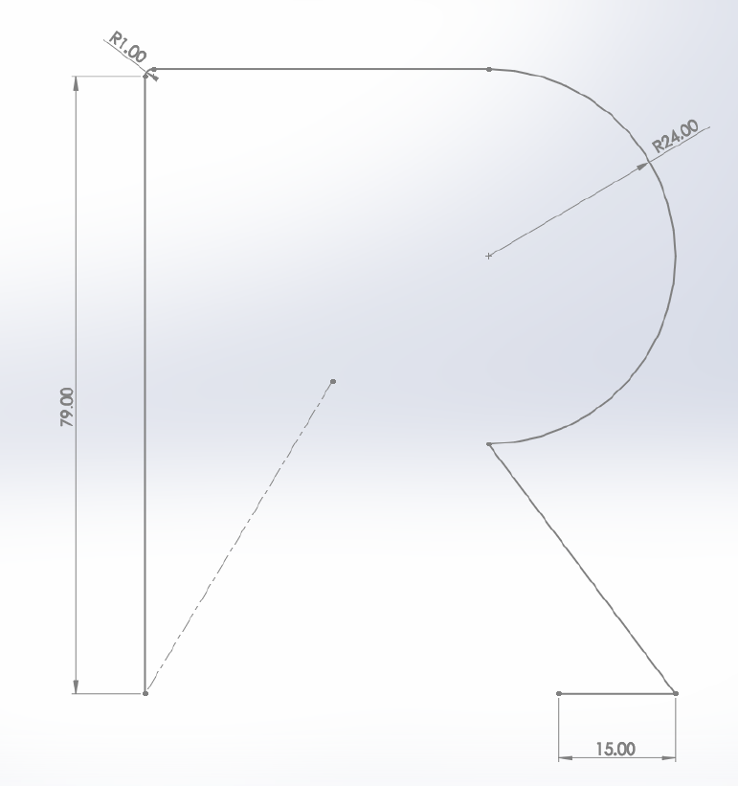
G1 X10. Y40.
G2 X10. Y-8. I0. J-24.
G1 X34. Y-40.
G1 X19. Y-40.
Y
C(-33,40)
D(10,40)
X
B(-34,39)
程式原點
E(10,-8)
A(-34,-40)
G(19,-40)
F(34,-40)

Slide 22
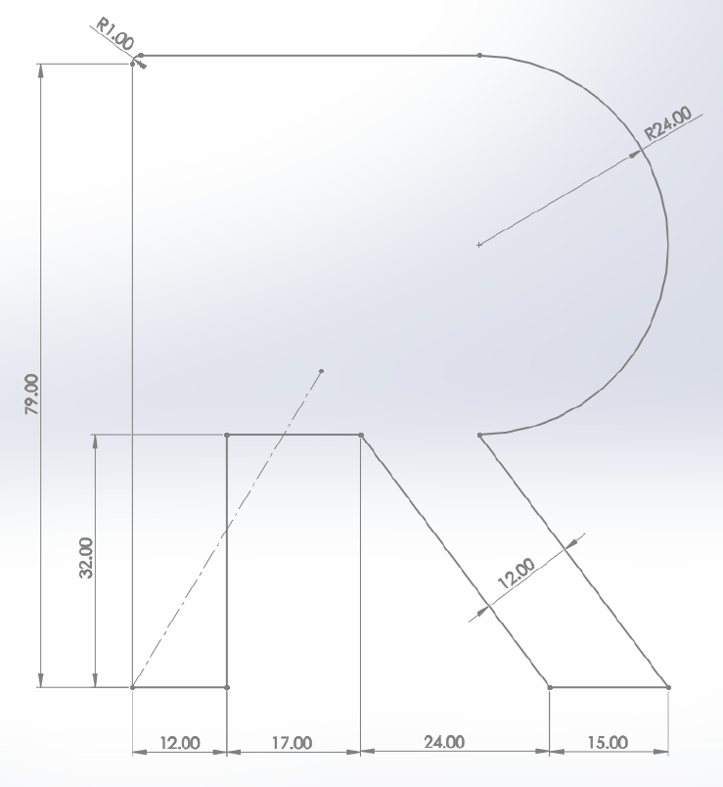
G1 X-5. Y-8.
G1 X-22. Y-8.
G1 X-22. Y-40.
G1 X-34. Y-40.
Y
C(-33,40)
D(10,40)
X
B(-34,39)
程式原點
E(10,-8)
I(-22,-8)
H(-5,-8)
A(-34,-40)
J(-22,-40)
G(19,-40)
F(34,-40)

Slide 23
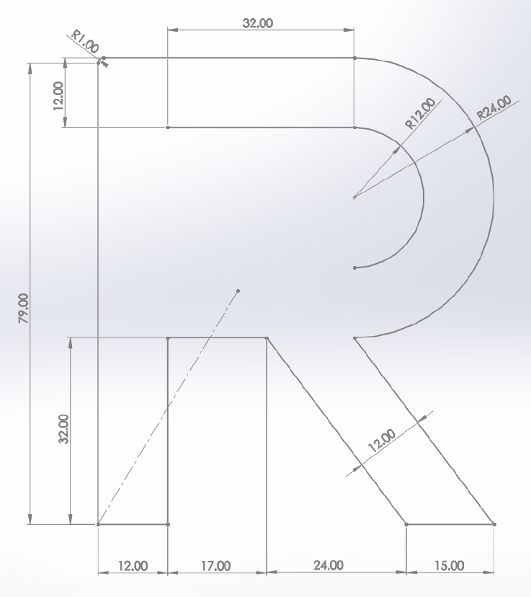
G4 P0
M05 S0
G0 X-22. Y28.
G4 P0
M03 S255
G4 P0
G1 X10. Y28.
G2 X10. Y4. I0. J-12.
Y
C(-33,40)
D(10,40)
X
B(-34,39)
J(-22,28)
K(10,28)
程式原點
L(10,4)
I(-22,-8)
H(-5,-8)
E(10,-8)
A(-34,-40)
J(-22,-40)
G(19,-40)
F(34,-40)

Slide 24
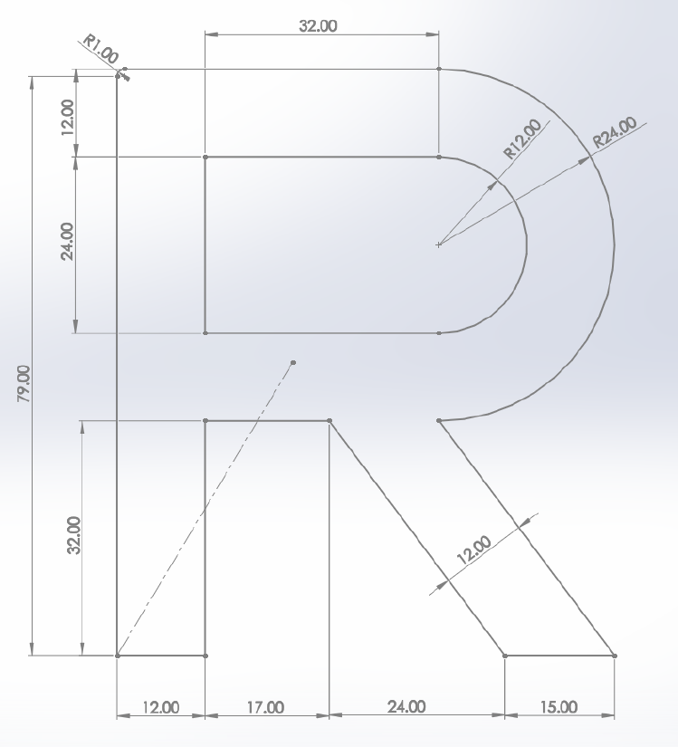
G1 X-22. Y4.
G1 X-22. Y28.
G4 P0
M05 S0
G0 X0 Y0
M18
Y
C(-33,40)
D(10,40)
X
B(-34,39)
J(-22,28)
K(10,28)
M(-22,4)
L(10,4)
E(10,-8)
I(-22,-8)
H(-5,-8)
A(-34,-40)
J(-22,-40)
G(19,-40)
F(34,-40)

Slide 25
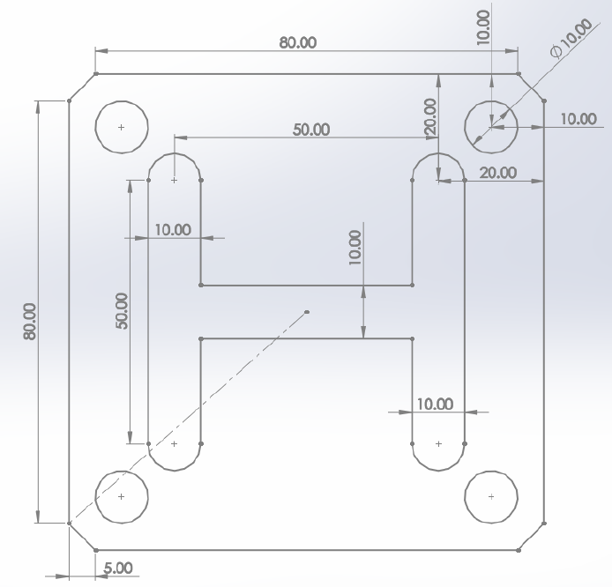
程式編輯 例題10
如圖所示，請用程式指令完成下方圖形輪廓，假設雷射起點在程式原點(0,0)上，請使用絕對座標完成下方圖形。
Y
C
D
X
E
B
I
J
N
O
R
S
P
Q
W
V
M
X
U
T
L
K
A
F
H
G

Slide 26
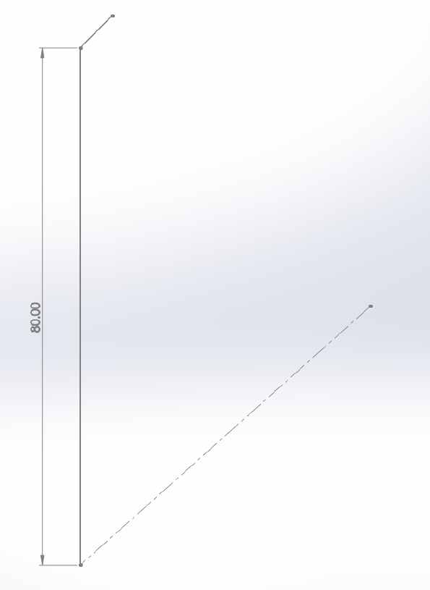
絕對座標 (G90)
M05 S0
G90
G21
G1 F600
G0 X-45. Y-40.
G4 P0
M03 S255
G4 P0
G1 F600
G1 X-45. Y40.
G1 X-40. Y45.
C(-40,45)
Y
B(-45,40)
X
程式原點
A(-45,-40)

Slide 27
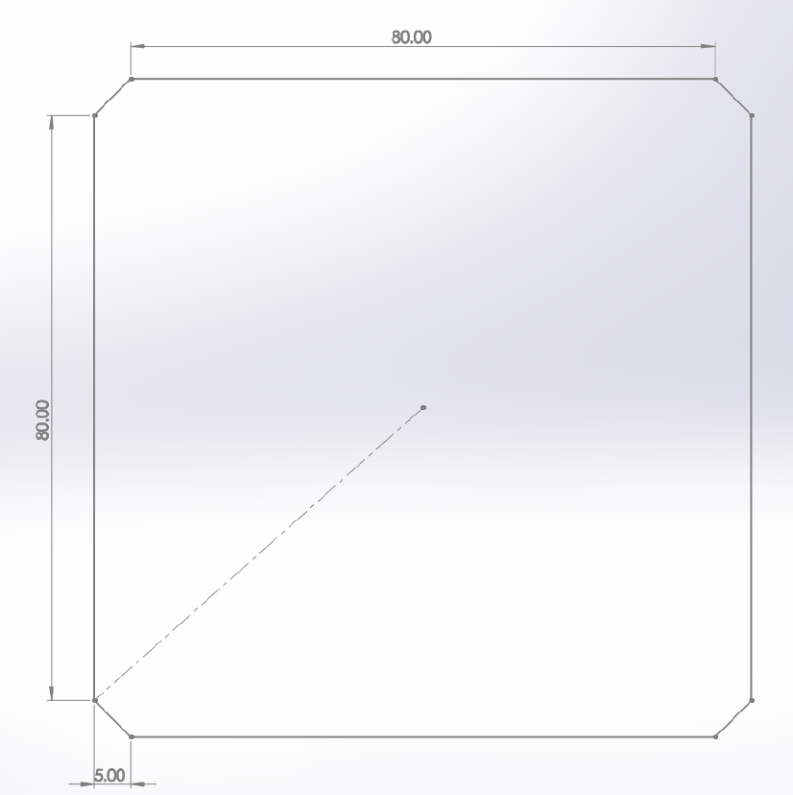
G1 X40. Y45.
G1 X45. Y40.
G1 X45. Y-40.
G1 X40. Y-45.
G1 X-40. Y-45.
G1 X-45. Y-40.
Y
C(-40,45)
D(40,45)
X
B(-45,40)
E(45,40)
程式原點
A(-45,-40)
F(45,-40)
H(-45,-40)
G(40,-45)

Slide 28
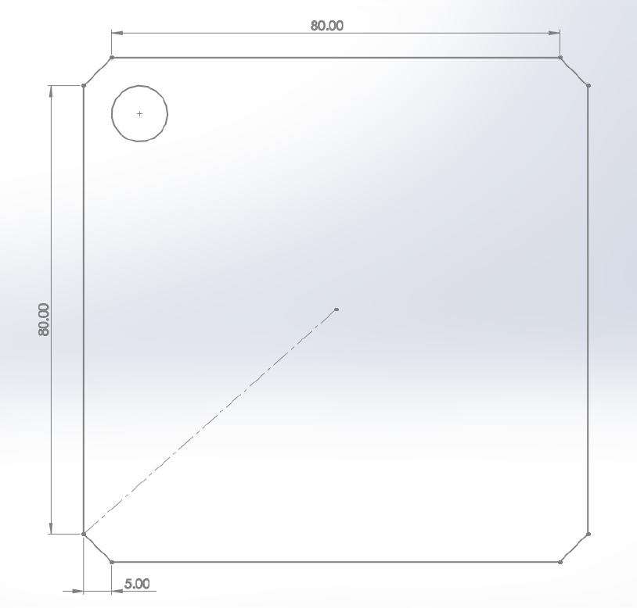
G4 P0
M05 S0
G0 X-35. Y30.
G4 P0
M03 S255
G4 P0
G3 X-35. Y30. I0. J5.
Y
C(-40,45)
D(40,45)
B(-45,40)
E(45,40)
X
I(-35,-30)
程式原點
A(-45,-40)
F(45,-40)
H(-45,-40)
G(40,-45)

Slide 29
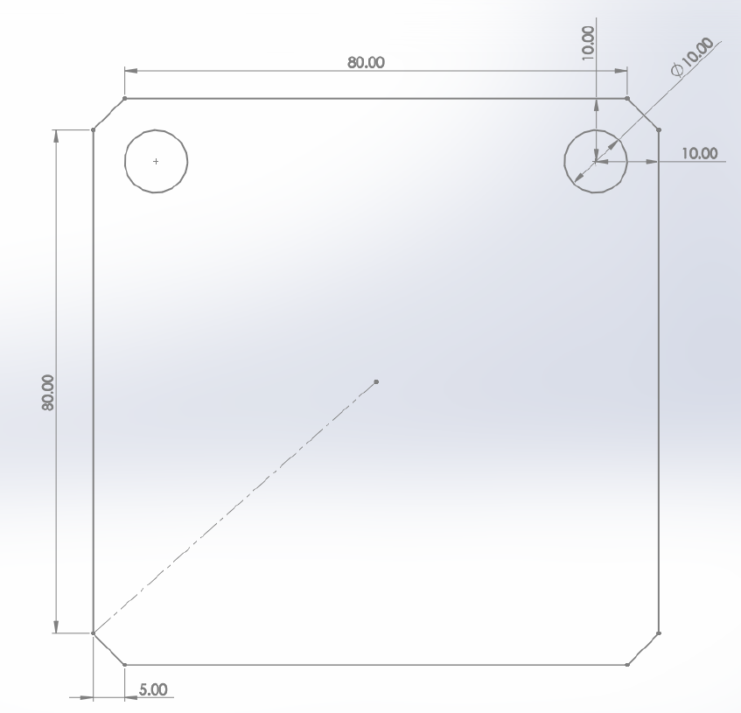
G4 P0
M05 S0
G0 X35. Y30.
G4 P0
M03 S255
G4 P0
G3 X35. Y30. I0. J5.
Y
C(-40,45)
D(40,45)
X
B(-45,40)
E(45,40)
I(-35,-30)
J(35,-30)
程式原點
A(-45,-40)
F(45,-40)
H(-45,-40)
G(40,-45)

Slide 30
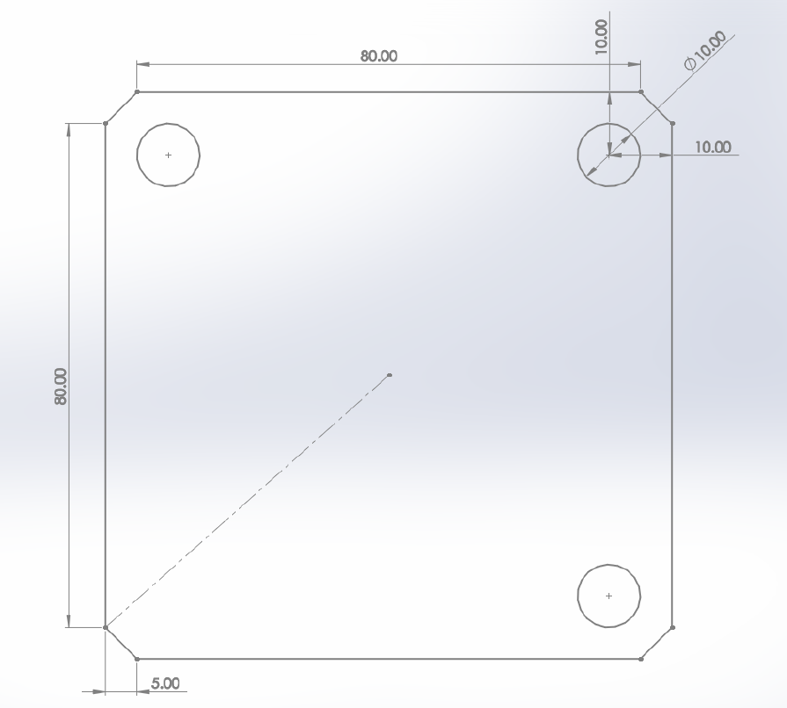
G4 P0
M05 S0
G0 X35. Y-40.
G4 P0
M03 S255
G4 P0
G3 X35. Y-40. I0. J5.
Y
C(-40,45)
D(40,45)
X
B(-45,40)
E(45,40)
I(-35,-30)
J(35,-30)
程式原點
A(-45,-40)
F(45,-40)
K(35,-40)
H(-45,-40)
G(40,-45)

Slide 31
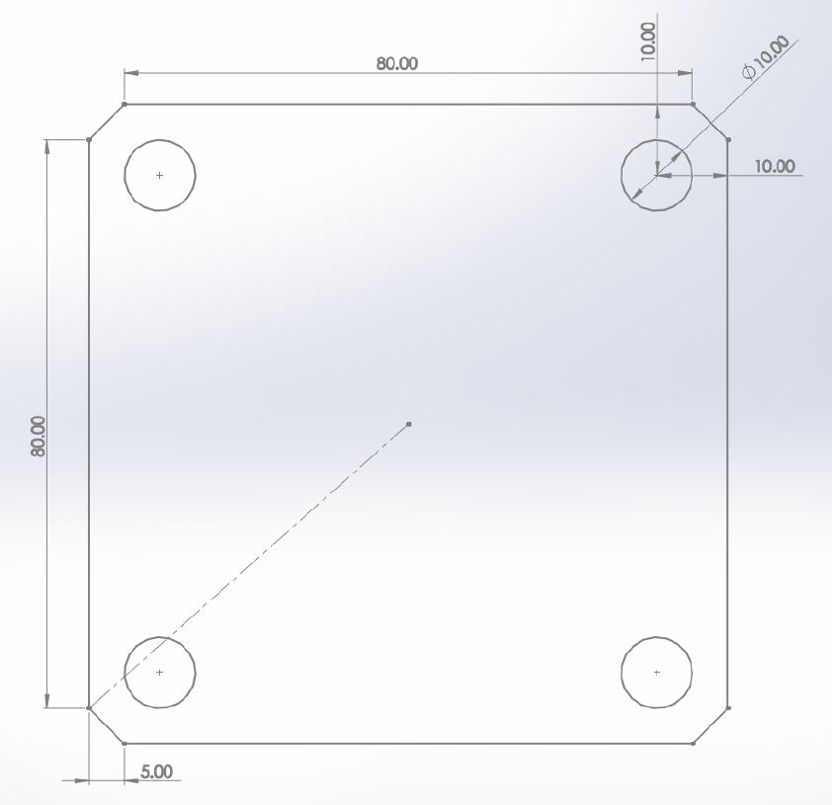
G4 P0
M05 S0
G0 X-35. Y-40.
G4 P0
M03 S255
G4 P0
G3 X-35. Y-40. I0. J5.
Y
C(-40,45)
D(40,45)
B(-45,40)
E(45,40)
X
I(-35,-30)
J(35,-30)
程式原點
A(-45,-40)
F(45,-40)
L(-35,-40)
K(35,-40)
H(-45,-40)
G(40,-45)

Slide 32
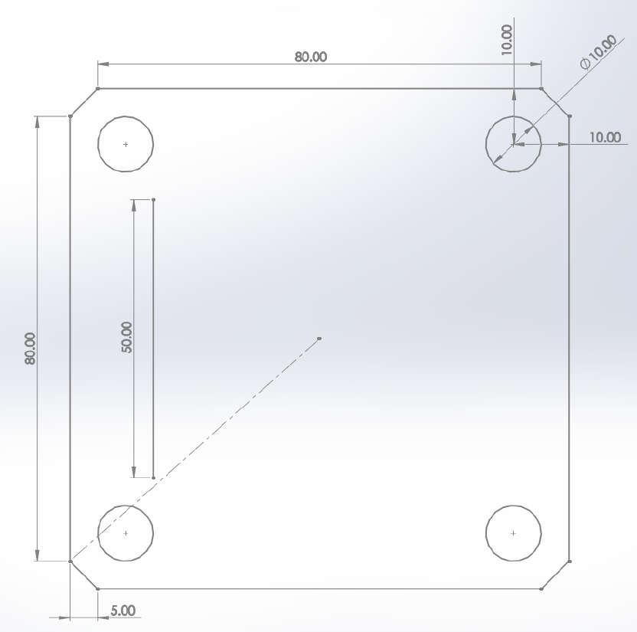
G4 P0
M05 S0
G0 X-30. Y-25.
G4 P0
M03 S255
G4 P0
G1 X-30. Y25.
Y
C(-40,45)
D(40,45)
B(-45,40)
E(45,40)
X
I(-35,-30)
J(35,-30)
N(-30,25)
程式原點
M(-30,-25)
A(-45,-40)
L(-35,-40)
K(35,-40)
F(45,-40)
H(-45,-40)
G(40,-45)

Slide 33
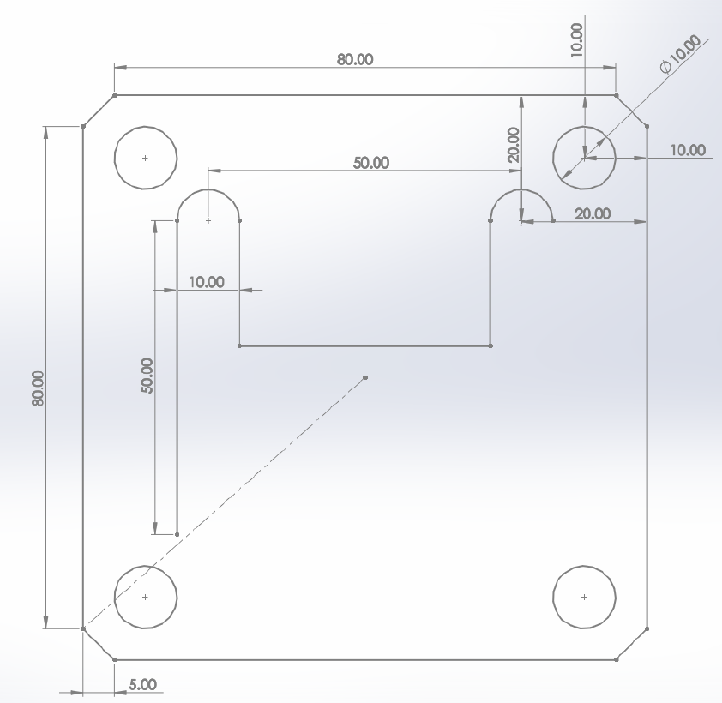
G2 X-20. Y25. I5. J0.
G1 X-20. Y5.
G1 X20. Y5.
G1 X20. Y25.
G2 X30. Y25. I5. J0.
Y
C(-40,45)
D(40,45)
X
B(-45,40)
E(45,40)
I(-35,-30)
J(35,-30)
N(-30,25)
O(-20,25)
R(20,25)
S(30,25)
P(-20,5)
Q(20,5)
程式原點
M(-30,-25)
A(-45,-40)
L(-35,-40)
K(35,-40)
F(45,-40)
H(-45,-40)
G(40,-45)

Slide 34
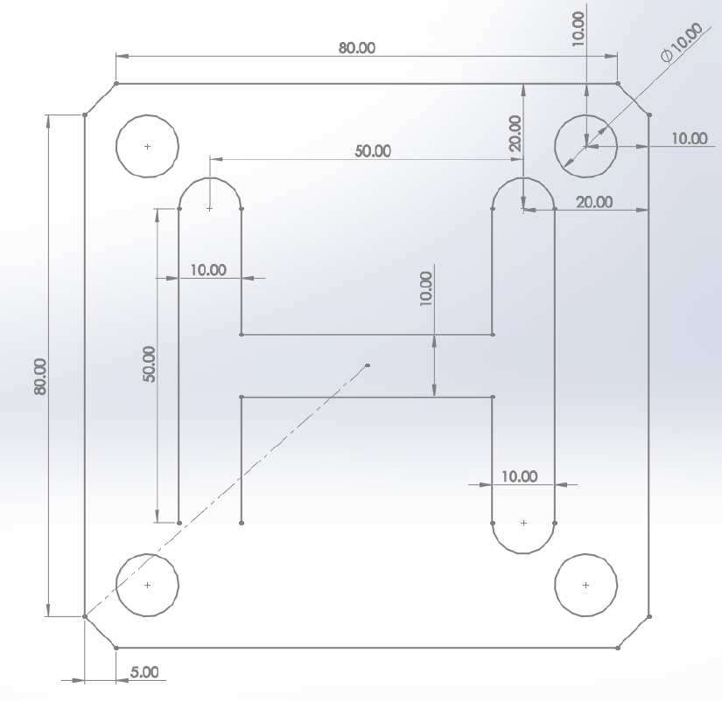
G1 X30. Y-25.
G2 X20. Y-25. I-5. J0.
G1 X20. Y-5.
G1 X-20. Y-5.
G1 X-20. Y-25.
Y
C(-40,45)
D(40,45)
X
B(-45,40)
E(45,40)
I(-35,-30)
J(35,-30)
N(-30,25)
O(-20,25)
R(20,25)
S(30,25)
P(-20,5)
Q(20,5)
程式原點
W(-20,-5)
V(20,-5)
M(-30,-25)
X(-20,-25)
U(20,-25)
T(30,-25)
A(-45,-40)
L(-35,-40)
K(35,-40)
F(45,-40)
H(-45,-40)
G(40,-45)

Slide 35
G2 X-30. Y-25. I-5. J0.
G4 P0
M05 S0
G0 X0 Y0
M18
Y
C(-40,45)
D(40,45)
X
B(-45,40)
E(45,40)
I(-35,-30)
J(35,-30)
N(-30,25)
O(-20,25)
R(20,25)
S(30,25)
P(-20,5)
程式原點
W(-20,-5)
V(20,-5)
M(-30,-25)
X(-20,-25)
U(20,-25)
T(30,-25)
A(-45,-40)
L(-35,-40)
K(35,-40)
F(45,-40)
H(-45,-40)
G(40,-45)

Slide 36
END

